Slide 1
IST718 Apache Spark
Willard Williamson
Adjunct Professor
iSchool, Syracuse University
linkedin.com/in/ncc-1701-d

Slide 2
Objectives
Describe Apache Spark
List Spark components and their functionalities
Explore Resilient Distributed Datasets
Describe the Spark MLlib
Perform Spark Operations

Slide 3
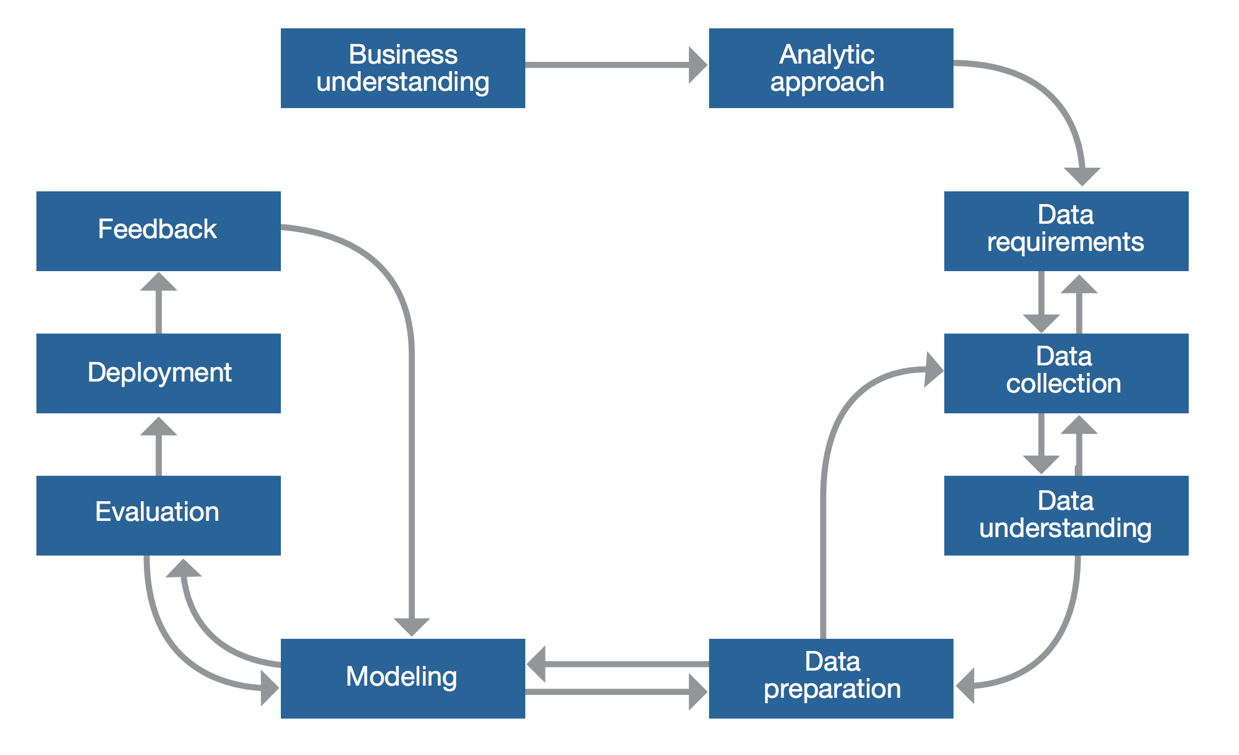
Typical data science cycle
Fom IBM’s Foundational Methdology for Data Science
See: https://tdwi.org/~/media/64511A895D86457E964174EDC5C4C7B1.PDF

Slide 4
Typical data science cycle
Fom IBM’s Foundational Methodology for Data Science

Slide 5
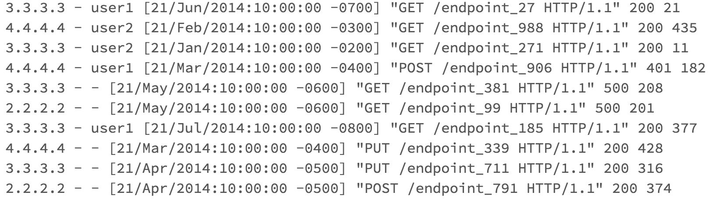
Example
Log files describing web site visits – Apache Logs
IP
Data and time of visit
Action and webpage
Response
Bytes

Slide 6
Example
Business question based on this data?
Data understanding steps?
Data preparation?

Slide 7
Example
Let’s assume we want to predict whether time of the day and month predicts the type of response

Slide 8
Example
With Apache Spark we will see how to take the raw input data and transform it non-destructively to clean it up or analyze it
RDD₁
RDD₂
RDD₃
RDD₄
DF₄
Linear Regression

Slide 9
Hadoop
Traditionally:
Hadoop uses single programming model: MapReduce
It only works with data on hard drives
I.O.
Map
Reduce
I.O.
Map
Reduce
I.O.
I.O.

Slide 10
Spark
RAM bandwidth has been increasing exponentially
Spark can perform in-memory computations

Slide 11
What is Spark?
Apache Spark is a fast, in-memory analytics system
Spark has several high-level tools, including:
ML: a machine learning library
Spark Streaming: enables high-throughput, fault-tolerant stream processing of live data streams
Spark SQL: runs SQL and HiveQL queries
GraphX: an API for graphs and graph-parallel computation
Spark can be executed in two ways:
Standalone
With a cluster manager such as YARN

Slide 12
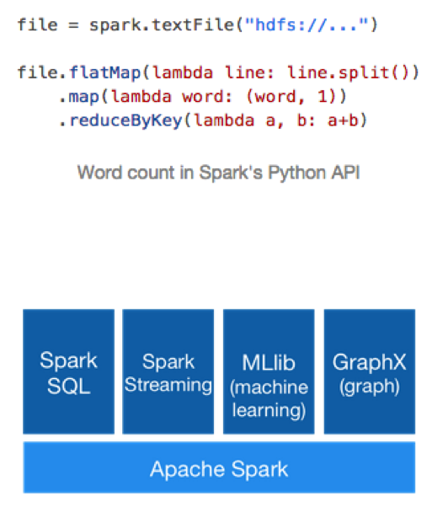
Spark
“Apache Spark™ is a fast and general engine for large-scale data processing.”

Slide 13
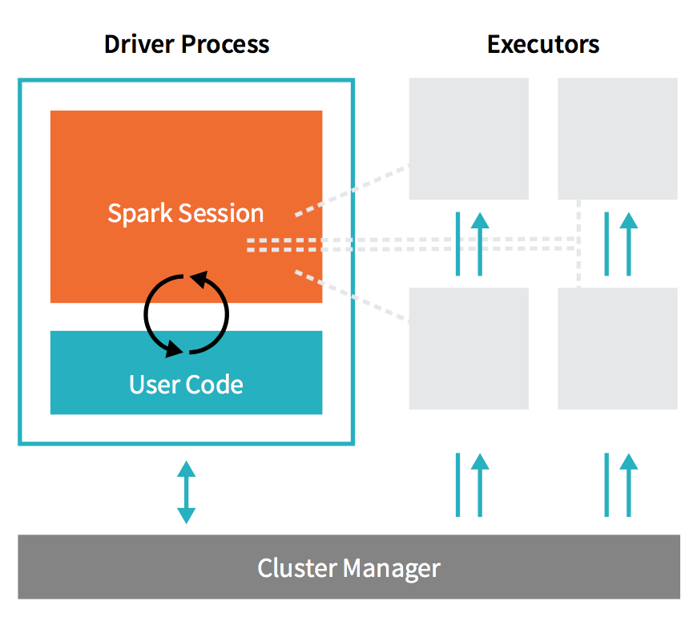
Spark Architectural Components
Spark applications consist of a driver process and a set of executor processes.

Slide 14
Spark Driver Process
The driver process runs the application’s “main” program
Runs on one of the nodes in the cluster
Is responsible for three things:
Maintaining information about the Spark applications
Responding to a user’s program or input
Analyzing, distributing, and scheduling work across the executors

Slide 15
Spark Executor Process
Responsible for actually carrying out the work that the driver assigns to them.
Each executor is responsible for two things:
Executing code assigned to it by the driver
Reporting the state of the computation on that executor back to the driver node

Slide 16
Cluster Manager
Controls the physical machines
Allocates resources to Spark applications
Three Cluster Managers
Standalone
YARN
Mesos

Slide 17
Spark 1.6+ vs 2.0+
Spark 1.6+ relied on transformations on arbitrary datasets known as Resilient Distributed Datasets (RDDs)
Spark 2.0+ defines more structure in the form of DataFrames, which are similar to tables in SQL and data.frames in R
The newest versions of Spark define DataSets which are statically-typed DataFrames (more structure)
With more flexiblity comes greater power but less performance
Future Spark machine learning will work with DataFrames and not RDD.

Slide 18
Classic Spark v. <2.0

Slide 19
The SparkContext
The SparkContext object performs the following tasks:
It connects to the ResourceManager (like YARN) and asks for resources on the Hadoop cluster,
Starts executors on the worker nodes in the cluster that the ResourceManager allocated for the Spark application,
Sends the application code to the executors,
And finally, it sends tasks for the executors to run
SparkContext is represented by the sc objec

Slide 20
Spark RDDs
An RDD (resilient distributed dataset) is a fault-tolerant collection of elements on which operations can be performed in parallel.
An RDD is an immutable collection that represents:
A dataset…
…broken up into a list of partitions
A list of dependencies on other RDDs
An optional list of preferred block locations for an HDFS file
Read-only

Slide 21
Important RDD Concepts
Lineage
Information about how an RDD is derived from other datasets or other RDDs
RDD is not necessarily materialized all the time due to lazy execution
Lineage captured on disk as “lineage graph”
Persistence
Indicate which RDDs which need to keep in memory for reuse
User can call “persist” method
Partitioning
RDD elements can be partitioned across machines based on a key in each record

Slide 22
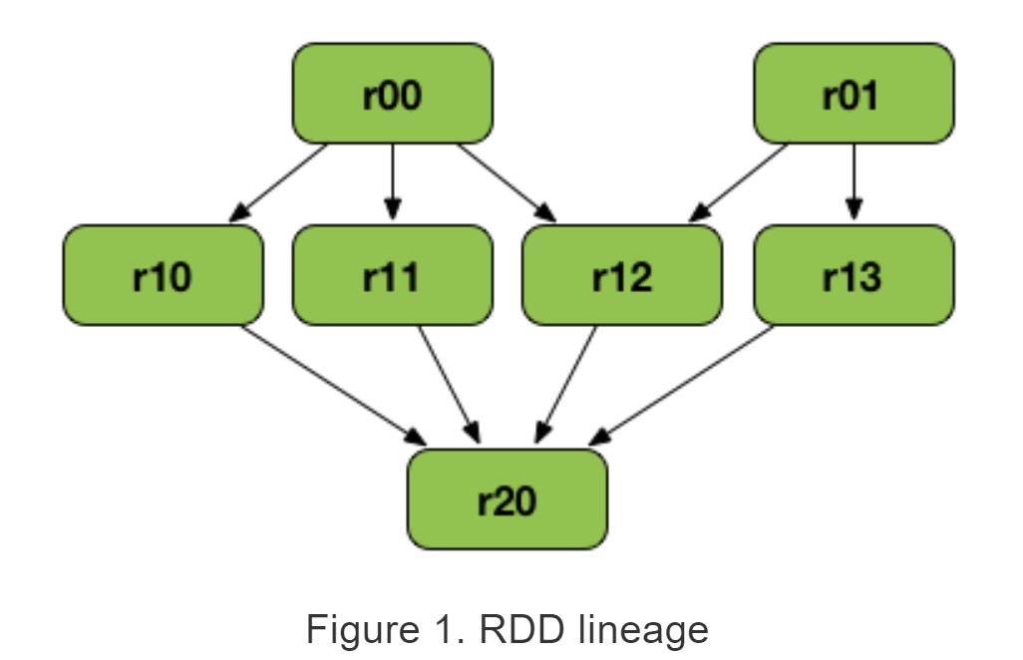
Sample RDD Lineage Graph
r20 depends on many other RDDs
See: https://jaceklaskowski.gitbooks.io/mastering-apache-spark/spark-rdd-lineage.html

Slide 23
Creating RDDs
Can create an initial RDD by applying a transformation to data on disk
Can create an initial RDD from a code object
Example ways to create an RDD in Spark:
Use the parallelize operation to convert an existing code object into an RDD
Use textFile operation to convert a text file on HDFS into an RDD
Use sequenceFile operation to convert a binary file on HDFS into an RDD

Slide 24
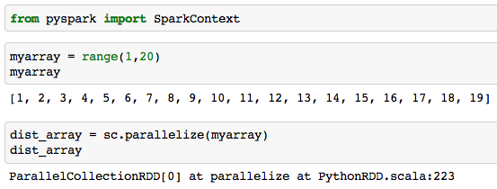
Example: Creating RDDs

Slide 25
RDD Persist
Spark’s persist method
Indicate which RDDs to reuse
Indicate if you want to replicate across machines
Indicate priority of which in-memory data to spill to disk first
Example
logsrdd = sc.textFile(“hdfs://user/mark/logdata”)
fatals = filter(lambda s: s.startswith(‘FATAL’), logsrdd)
fatals.cache()
fatals.count()
# Notes: logsrdd NOT loaded into RAM because of lazy evaluation
# fatals.cache() = rdd.persist(storageLevel.MEMORY) tries to persist fatals rdd in memory

Slide 26
RDD Disk and Recover
RDD can spill to disk
Degrade gracefully (to mapreduce performance)
Partitions not in use/lesser use and/or low priority spilled first
Failure Recovery
Recovery is facilitated through redundant RDD block copies across cluster computers.
An RDD partition that fails is recovered by the Yarn/Spark Driver
Executer applies lineage to prior RDD (or original data on disk) to recover the RDD.

Slide 27
RDD Checkpointing
Writes an RDD to disk to save the RDD in a specific state
After checkpointing, future references the RDD don’t need to perform upstream transformations in the lineage.
Similar to caching except that the RDD is stored on disk instead of in memory.
Example:
spark.sparkContext.setCheckpointDir("/some/path/for/checkpointing") words.checkpoint()

Slide 28
RDD Operations
There are two types of operations that can be done on RDDs:
Transformations: create a new dataset/RDD from an existing one
Actions: Trigger a transformation and instructs spark to compute a result from a series of transformations.
Transformations
lazy - they do not compute their results right away
Actions
Instantiates the RDD
See https://spark.apache.org/docs/latest/rdd-programming-guide.html#transformations for a list of transformations and actions.

Slide 29
RDD Dependencies and Transformations
Dependency / transformation used synonymously in Spark the Definitive Guide text book
Two Main Types of Dependencies / Transformation
Narrow – child partition depends on only one parent partition
E.g. map, filter, union
Wide – multiple child partitions depend on one parent partition
E.g. Join and group-by transformations
Materialize intermediate calculations on parent for fault recovery

Slide 30
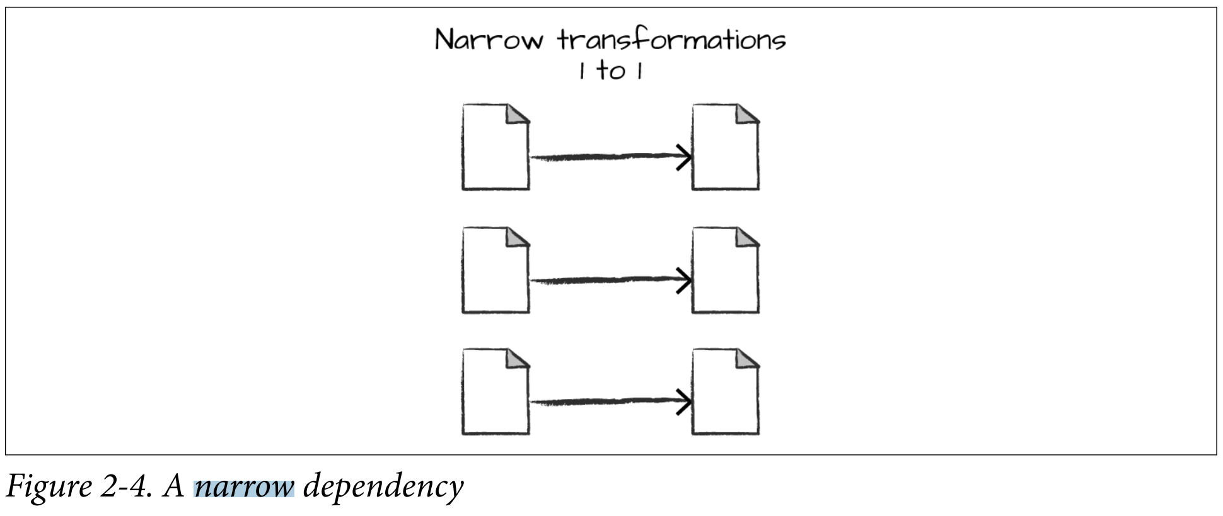
Narrow Transformation / Dependency
Each input partition contributes to one output partition
See Spark the Definitive Guide, Figure 2.4
Also called pipelining, spark tries to perform narrow operations in memory

Slide 31
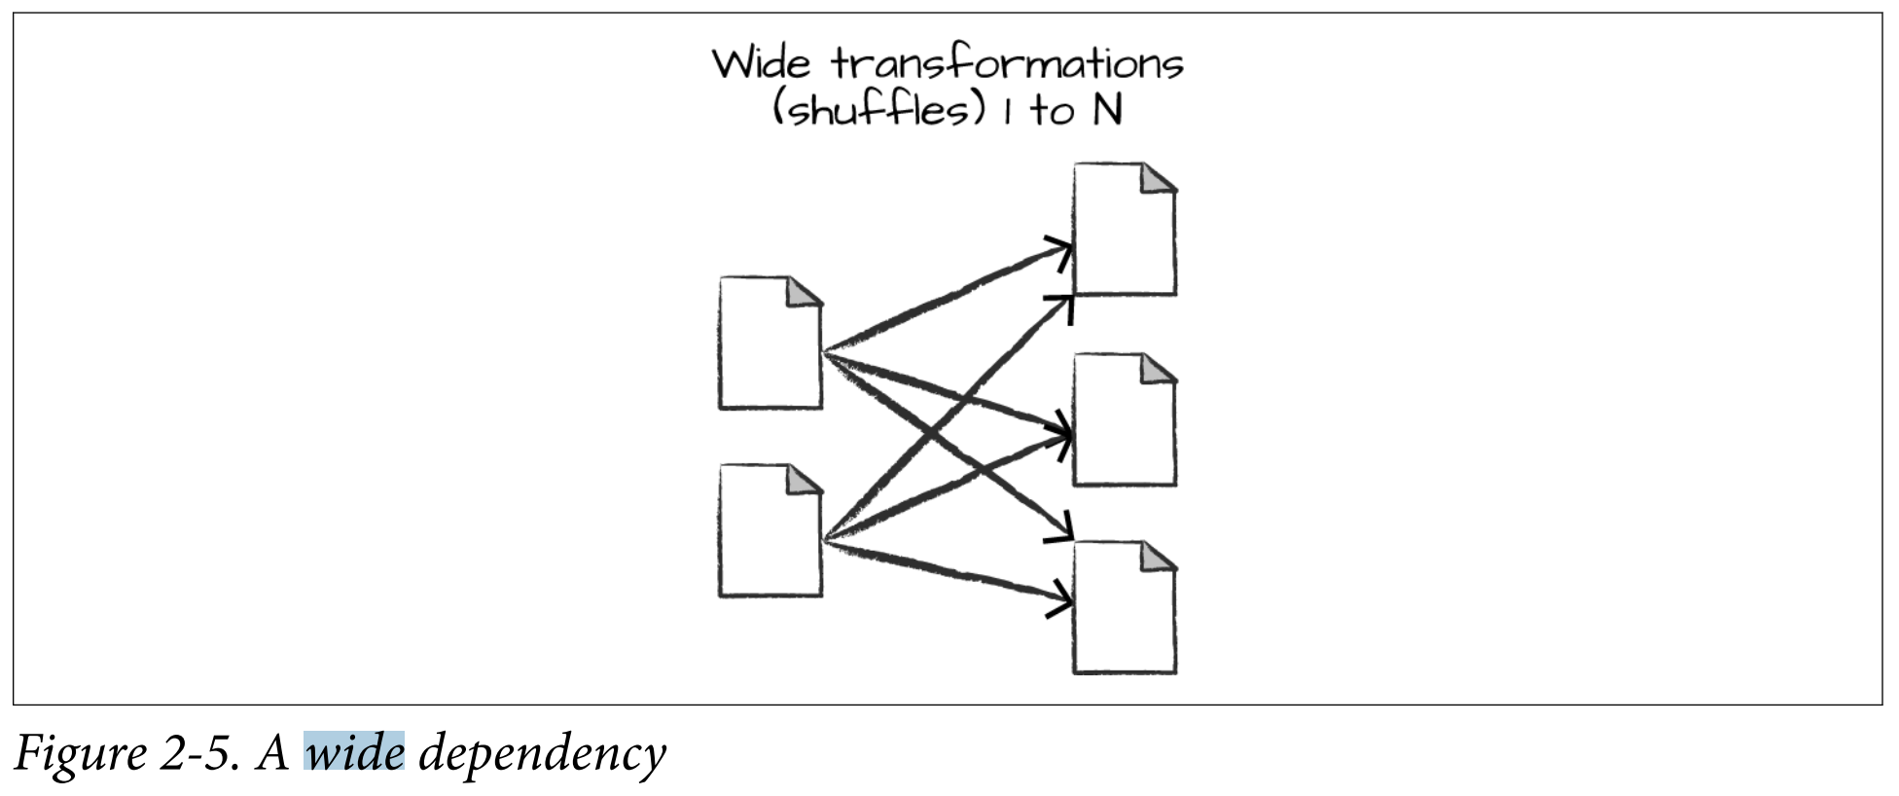
Wide Transformation / Dependency
An input partition contributes to many output partitions
See Spark the Definitive Guide, Figure 2.5
Also called a shuffle where Spark exchanges partitions across the cluster

Slide 32
Example Transformations
map(func): returns a new distributed dataset formed by passing each element of the source through the function func.
flatMap(func): same as map but when multiple key-value pairs are returned
filter(func): return a new dataset formed by selecting those elements of the source on which func returns true.
reduceByKey(func): when called on a dataset of (K, V) pairs, returns a dataset of (K, V) pairs where the values for each key are aggregated using the given reduce function func.
sortByKey([ascending],[numTasks]): when called on a dataset of (K, V) pairs where K implements Ordered, returns a dataset of (K, V) pairs sorted by keys in ascending or descending order, as specified in the Boolean ascending argument.
join(otherDataset, [numTasks]): when called on datasets of type (K, V) and (K, W), returns a dataset of (K, (V, W)) pairs with all pairs of elements for each key.
distinct([numTasks]): returns a new dataset that contains the distinct elements of the source dataset.
pipe(command, [envVars]): pipes each partition of the RDD through the provided shell command

Slide 33
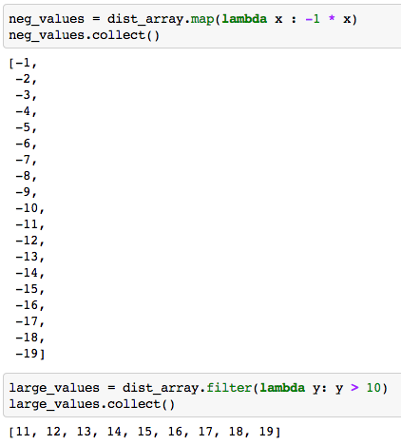
Example: Transformations

Slide 34
Example Actions
reduce(func): Aggregate the elements of the dataset using a function func (which takes two arguments and returns one). The function should be commutative and associative so that it can be computed correctly in parallel.
foreach(func): Runs the function func on each element in the dataset.
count(): returns the number of elements in the dataset.
first(): returns the first element in the dataset.
take(n): returns an array with the first n elements of the dataset.
saveAsTextFile(path): writes the elements in the dataset out to a file in HDFS (or some other file system).
saveAsSequenceFile(path): writes the elements to HDFS in the SequenceFile format.

Slide 35
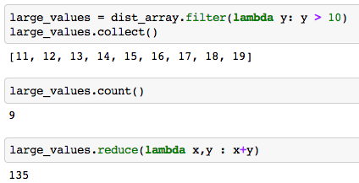
Example: Actions

Slide 36
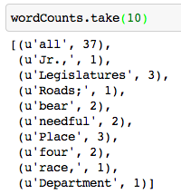
WordCount in Spark (1 of 2)
constitution = sc.textFile("/user/root/constitution.txt")
wordCounts = constitution.flatMap(lambda line: line.split())
.map(lambda word: (word, 1))
.reduceByKey(lambda a, b: a+b)

Slide 37
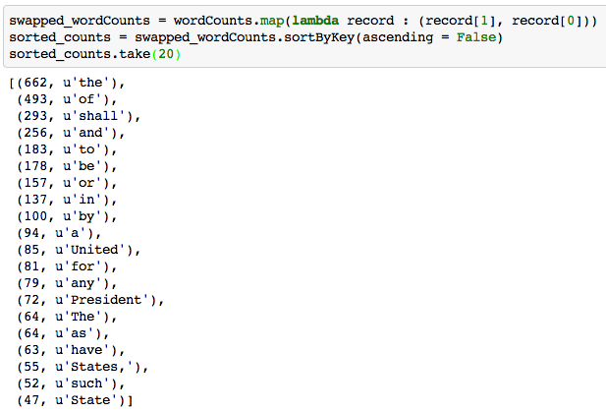
WordCount in Spark (2 of 2)

Slide 38
Operations on key-value pair RDDs
Operations on key-value pair datasets are at the foundation of Hadoop, MapReduce, and Spark 1.6
groupByKey(): group values with the same key, ex. rdd.groupByKey()
mapValues(f): applies function only to values not keys
flatMapValues(f): same as mapValues when function returns several values
keys(): Returns RDD with only the keys
values(): Returns RDD with only the values
Simple operations on RDDs:
union(otherRDD): makes the union of all key-value pairs

Slide 39
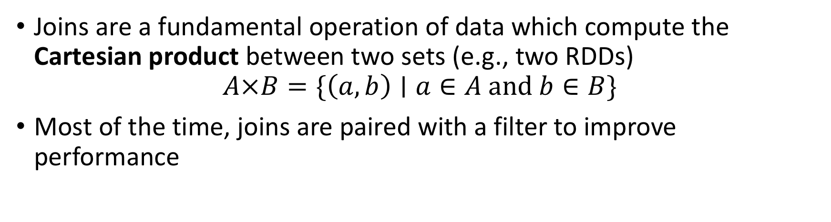
Join operations on pairs of key-value pair RDDs: join operations
Joins are a fundamental operation of data which compute the Cartesian product between two sets (e.g., two RDDs)
$$A×B=\{\left(a,b\right)∣a∈A and b∈B\}$$
Most of the time, joins are paired with a filter to improve performance

Slide 40
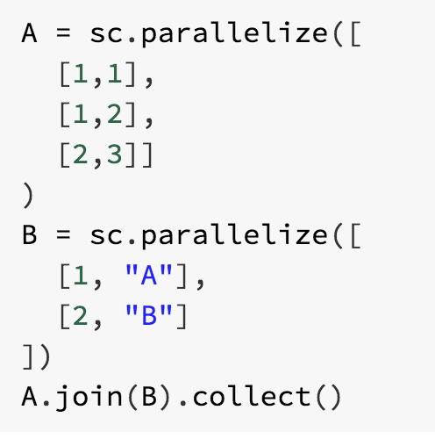

Join operations on pairs of key-value pair RDDs: join operations
We can use this idea to join key-value pairs and then filter for pairs that have the same key
RDD join performs an “inner join”
Inner Join: Keys must be present in the left and right hand RDD.

Slide 41
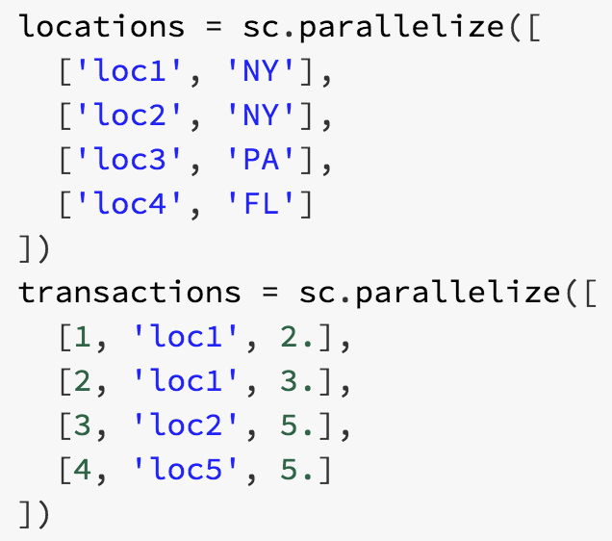
Join operations on pairs of key-value pair RDDs
Lets suppose we want to compute the total number of orders per state using:
Locations: locationID, state
Transactions: transactionID, locationID, number of orders
Activity: how can we use join to achieve this?
Explore leftOuterJoin and rightOuterJoin

Slide 42
Spark 2.0
DataFrames

Slide 43
DataFrames
The problem with RDDs is that they do not have enough structure
They are harder to optimize and therefore slow
DataFrames tries to solve this by adding structure
A DataFrame is a distributed collection of data organized into named columns
Similar to Pandas DataFrames but distributed across the cluster
You access the Spark 2.0+ functionality using the spark object

Slide 44
DataFrames (2)
You can read from multiple sources into dataframes

Slide 45
DataFrames (3)
One preferred source is Parquet files
Parquet files are datasets stored in columns

Slide 46
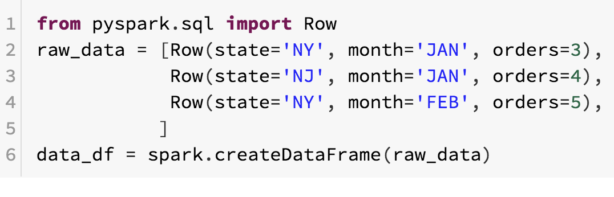
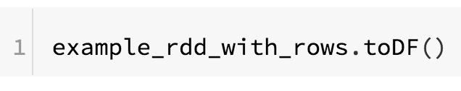
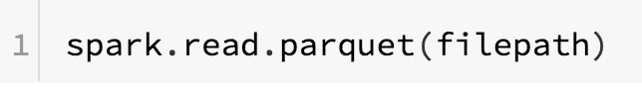
DataFrame operations
Creation of dataframes:
From Row objects:
From RDDs:
From files:

Slide 47
DataFrame operations
All data in a specific column has the same type
DataFrame types can be hierarchical: The type of a column might be another “DataFrame”
You cannot perform dataframe operations using Python
Instead, you transform DataFrames by selecting, modifying, filtering, joining, grouping, or aggregating using specialized Spark commands similar to SQL
Many of these commands are symbolic representations of the operations
After the transformations, Spark builds an execution plan that is optimized for the column types and the operations

Slide 48
Exploring a DataFrame
printSchema(): shows the datatypes of the dataframe
show(): prints the first n rows
take(): return first n rows
sample(withReplacement, fraction): randomly sample rows (approximate)
display(df): (only in DataBricks) exploratory interface for dataframe

Slide 49
Selecting and modifying a DataFrame
select(*expressions): returns a new DataFrame with columns
withColumn(colName, expression): creates a new column based on the expression
Expressions are symbolic operations
Symbolic operations can hold literal values and placeholders for column names
You can perform symbolic operations on both literals and placeholders
Some symbolic operations are available in pyspark.sql.functions

Slide 50
Examples
Examples on the following slides are implemented in the ‘Introduction to Spark and DataFrames.ipynb” ipython notebook.

Slide 51
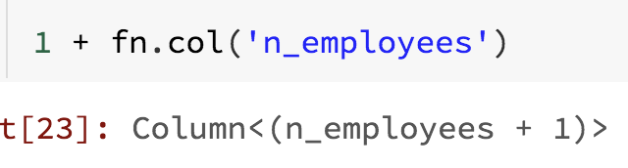
Symbolic operations
expression = 1 + n_employees
To express the previous operation, I need a literal value (1) and a placeholder for the column n_employees
A symbolic operation produces a column object which contains the defined operations

Slide 52
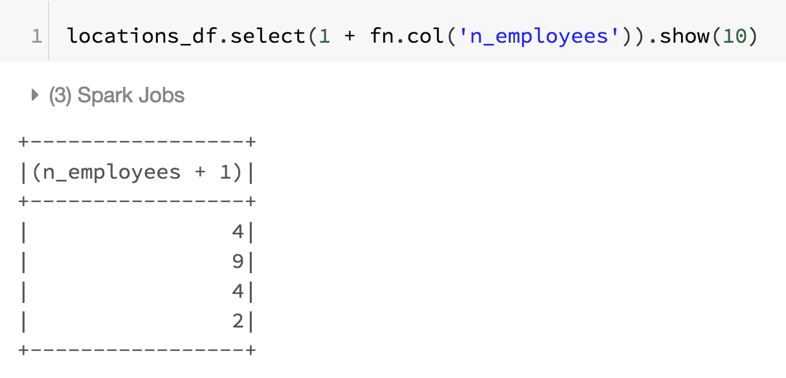
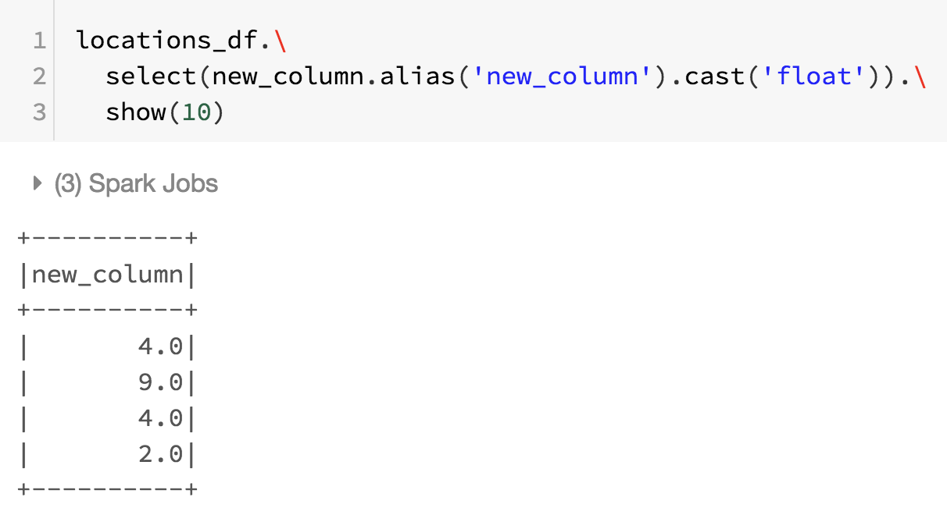
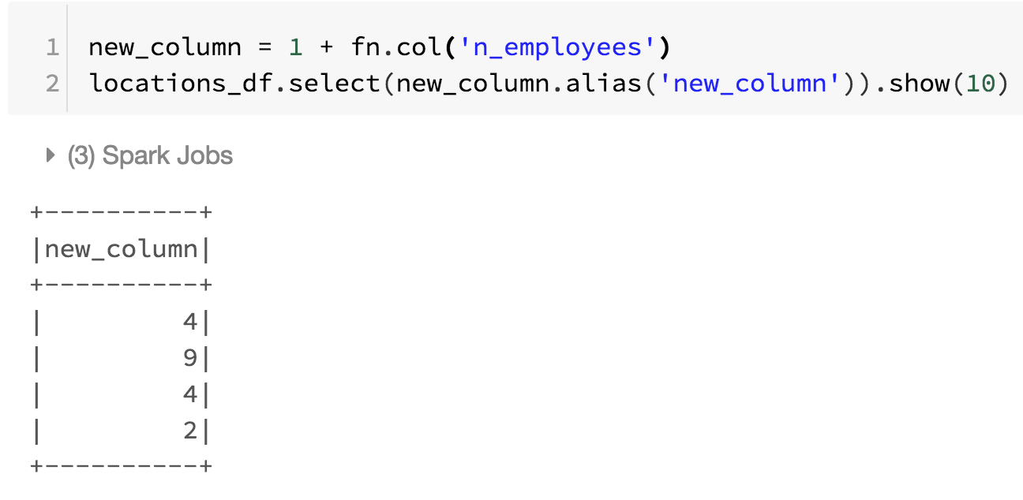
Symbolic operations
Change column type
Change column name

Slide 53
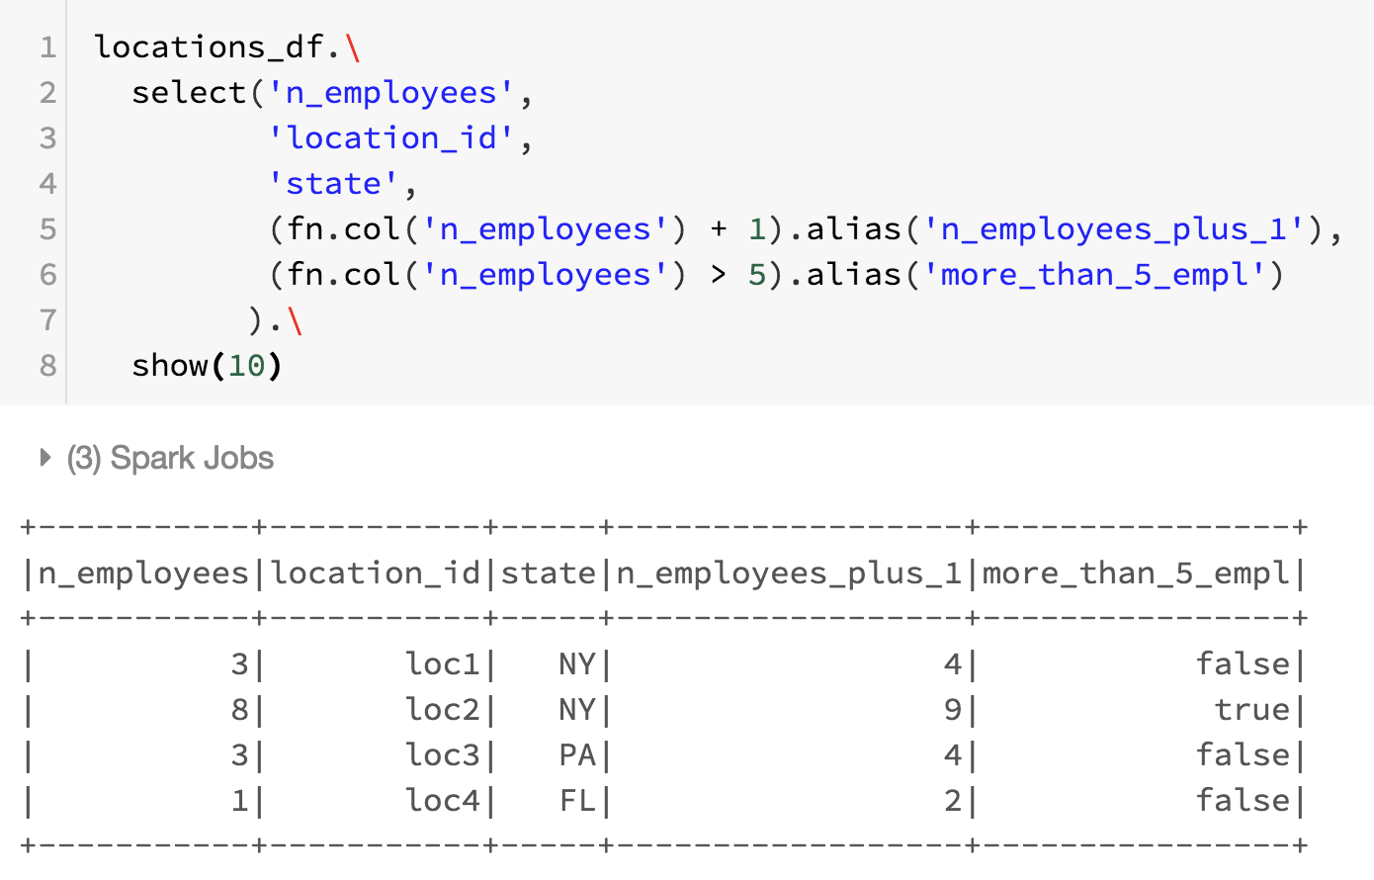
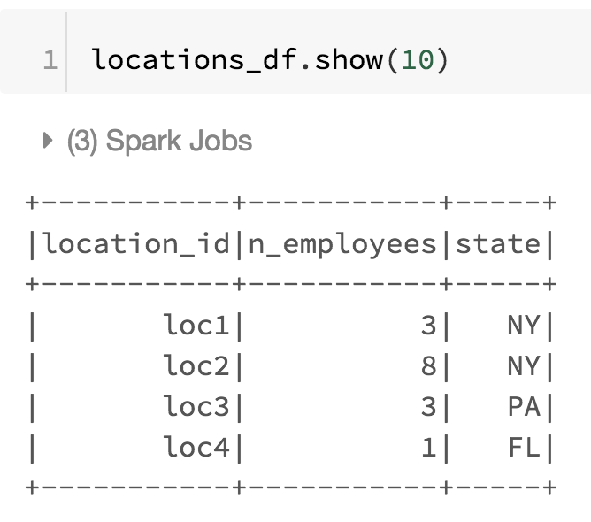
Selecting and modifying (1)
You can use select to select columns, modify them, or create new columns

Slide 54
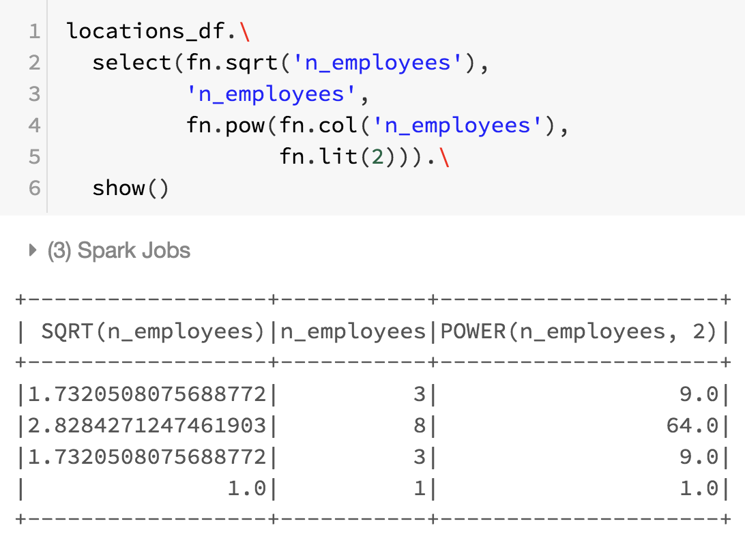
Selecting and modifying (2)
The following code snippet in that new columns are created using utility functions provided by the Spark SQL utility function (fn) module.
Note that fn.lit() is needed to create a literal passed to pow

Slide 55
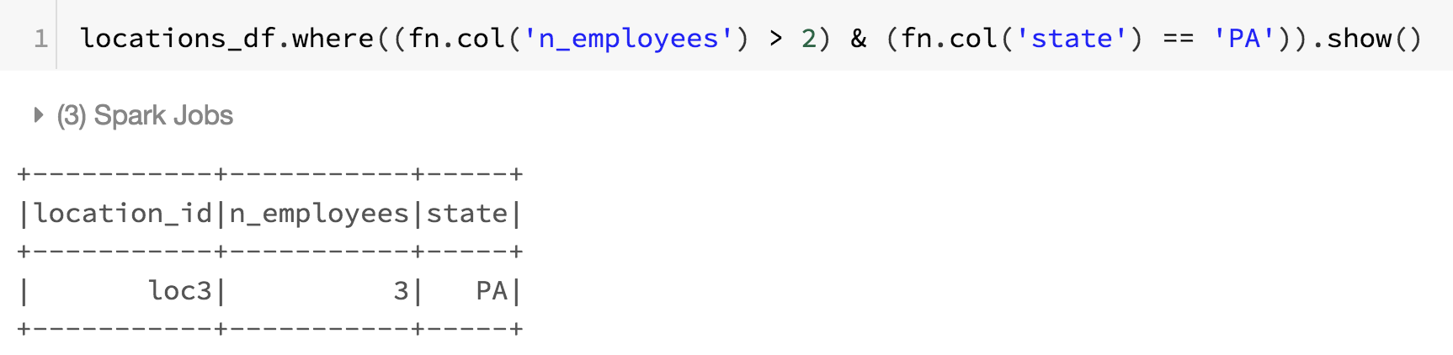
Filtering
where(expression): select only rows where expression is true
Expressions can be complex:

Slide 56
Joining
Inner joins (keep rows with keys that exist in the left and right datasets)
Outer joins (keep rows with keys in either the left or right datasets)
Left outer joins (keep rows with keys in the left dataset)
Right outer joins (keep rows with keys in the right dataset)
Left semi joins (keep the rows in the left, and only the left, dataset where the key appears in the right dataset)
Left anti joins (keep the rows in the left, and only the left, dataset where they do not appear in the right dataset)
Natural joins (perform a join by implicitly matching the columns between the two datasets with the same names)
Cross (or Cartesian) joins (match every row in the left dataset with every row in the right dataset)

Slide 57
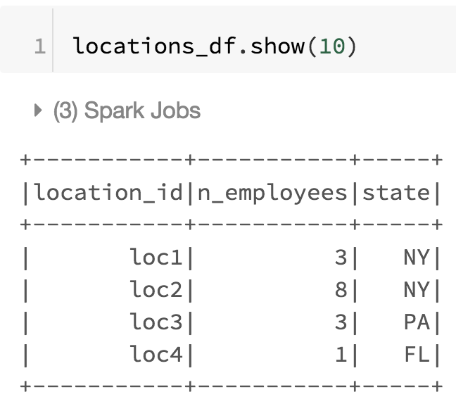
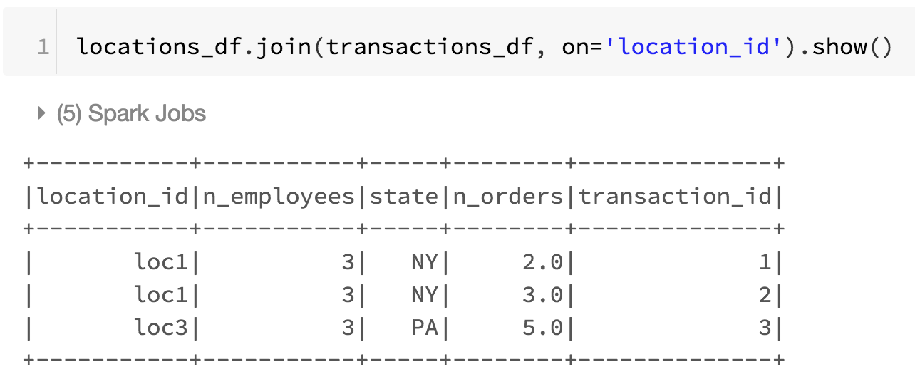
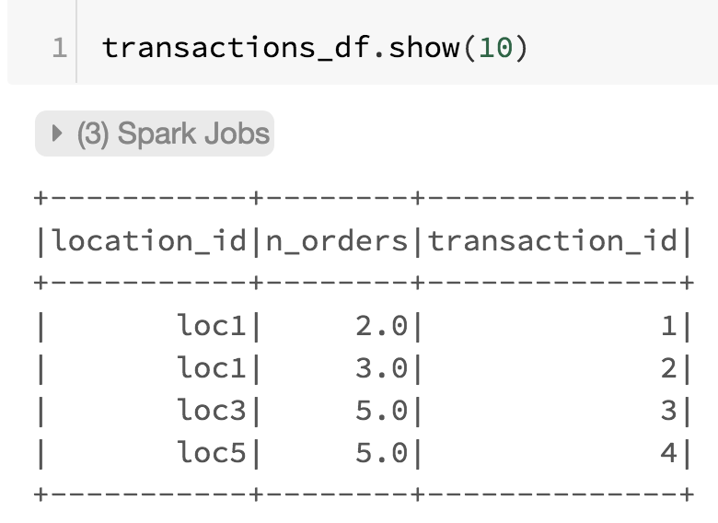
Inner Join
Keep rows with keys that exist in left and right data frames

Slide 58
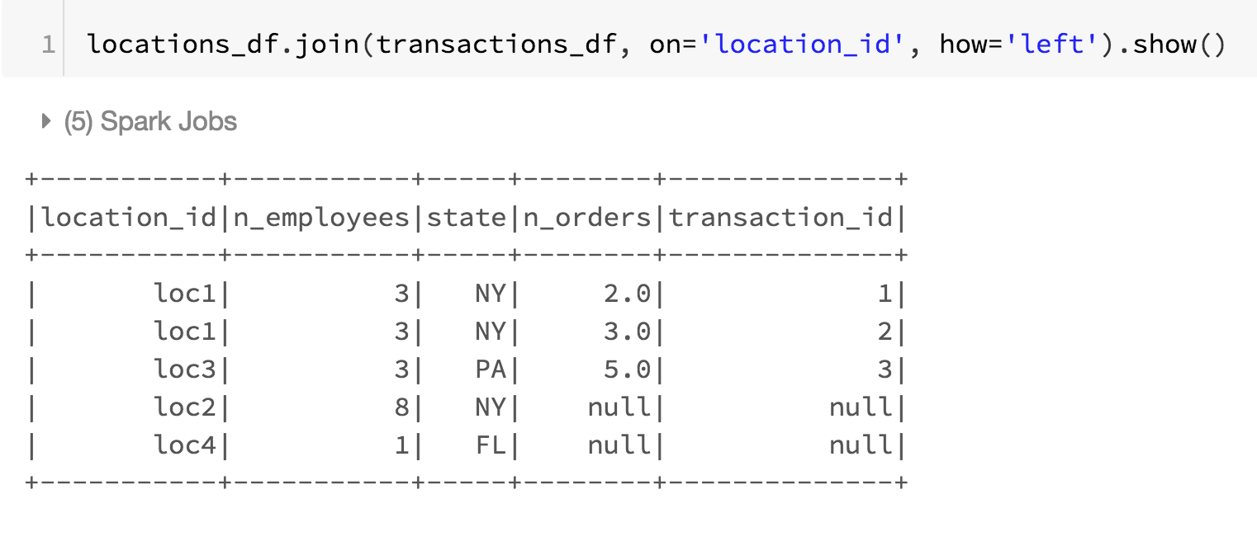
Left outer join
Keep rows with keys that exist in left data frame

Slide 59
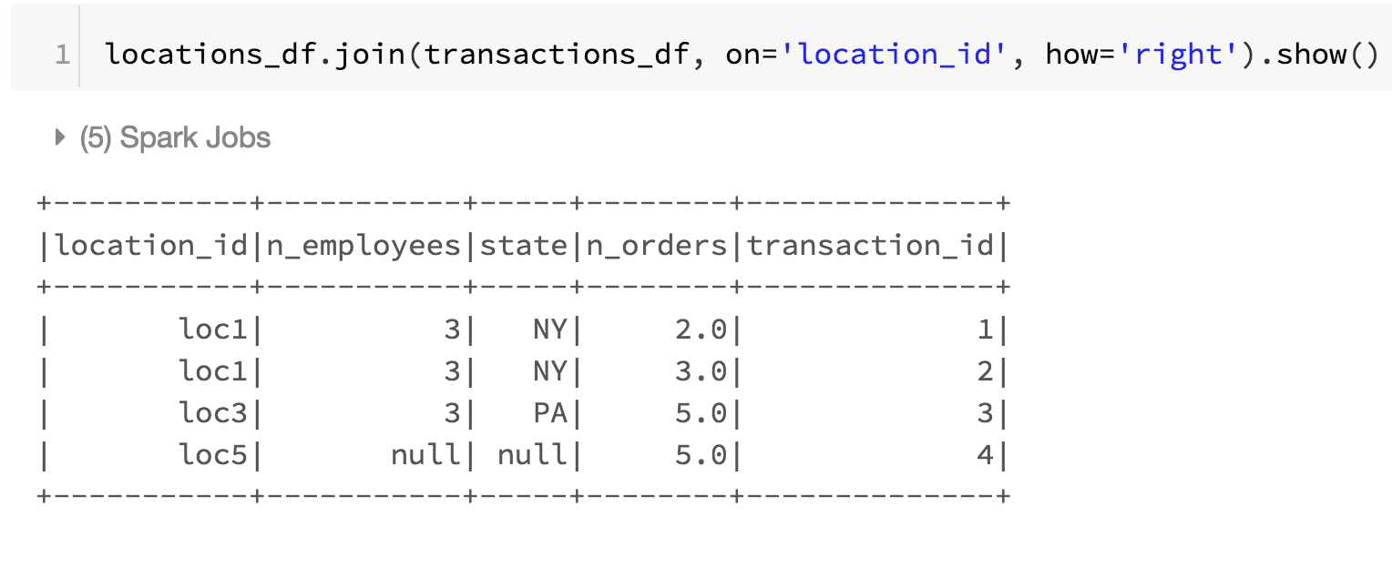
Right outer join
Keep rows with keys that exist in right data frame

Slide 60
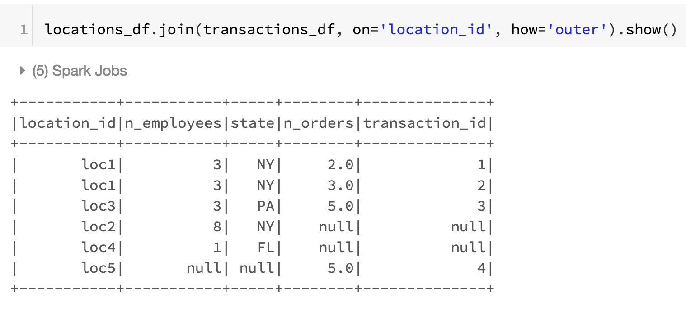
Outer join
Keep rows with keys that exist in either the left or right data frames

Slide 61
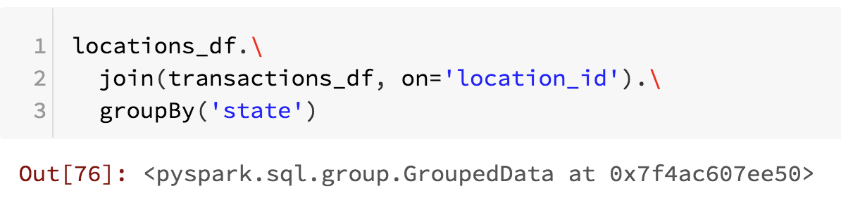
Grouping
groupBy(*expressions): groups by a list of expressions
Typically, a list of columns:
Note that this transformation not do anything until we perform an action on the group object like an aggregate action.

Slide 62
Aggregate
There are some special functions that only work on grouped data
They are applied using the method agg(*expressions)
For example:
fn.sum, fn.stddev: self explanatory
fn.count: counts when column is not null
fn.countDistinct: how many distinct values of a column

Slide 63
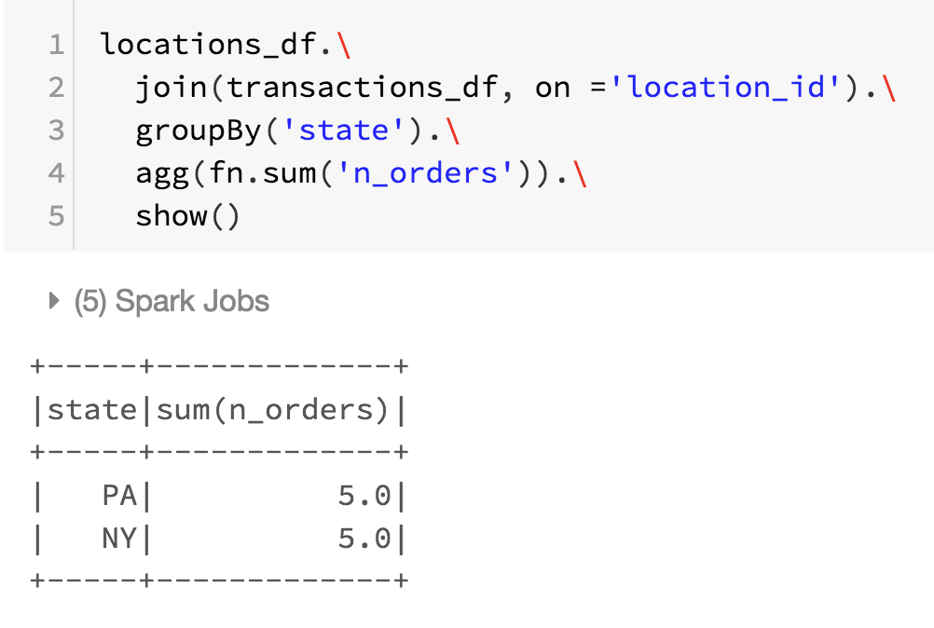
Aggregate

Slide 64
End of examples

Slide 65
Spark ML
Spark ML implements several machine learning algorithms at scale:
Regression
Classification
Decision Trees
Clustering
It works on Spark DataFrames by performing transformations of the data
A typical data science analysis requires several transformations
These transformations can be implemented through Pipelines

Slide 66
Spark ML (2)
A model is known as Estimator in Spark ML and the typical cycle for such objects is as follows
Define zero or more input columns
Define zero or more output columns
Define parameters of the estimator
Fit the estimator, which returns a fitted model
Use the fitted model to perform transformations

Slide 67
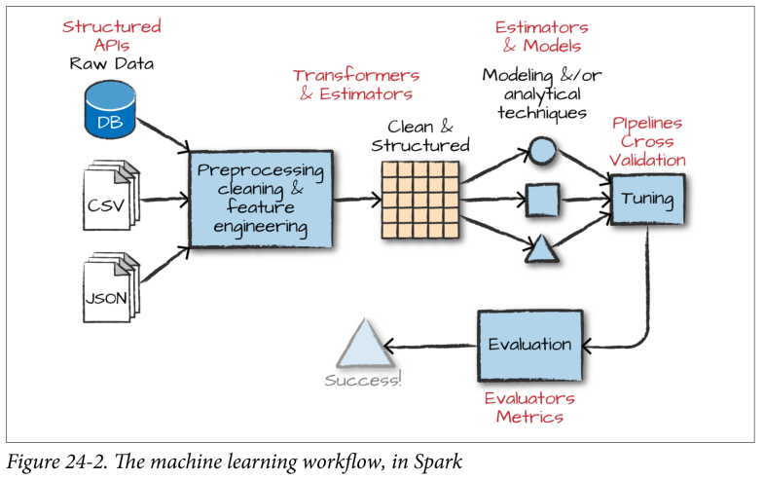
Example Spark machine learning workflow

Slide 68
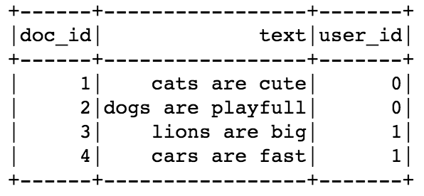
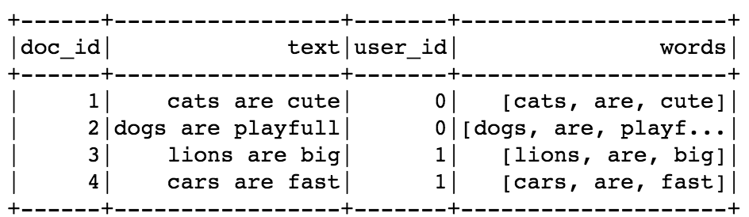
Spark ML: Transformers and Estimators
Note that Spark ML for RDD is getting deprecated
Preferred method in the future is to work only with DataFrames.
Spark Machine Learning works by creating transformers and estimators DataFrames as inputs
text
Tokenizer
(transformer)
words

Slide 69
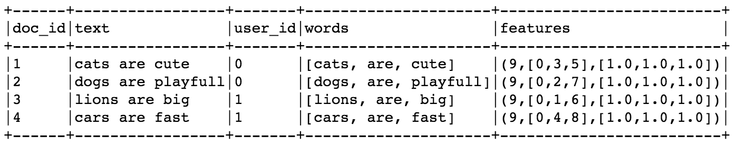
Spark ML: Transformers and Estimators
Transformers: An algorithm which converts one data frame into another data frame
Estimators: An algorithm which can be fit on a data frame to produce a transformer
For example, if we want to count terms in text, we need to know how many terms are in all documents
words
CounterVectorizer
(estimator)
CounterVectorizer
(transformer)
vocabulary
words
CounterVectorizer
(transformer)
features

Slide 70
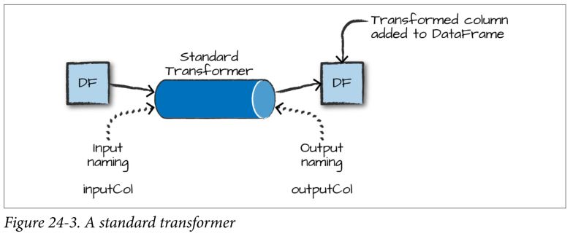
Example Spark Transformer

Slide 71
Spark ML: Pipelines
Data science is all about building data analytic pipelines from raw data to models
Spark ML Pipeline chains multiple Transformers and Estimators
Pipelines can be saved and shared
A Pipeline always starts as an Estimator that needs to be fitted
Pipeline (estimator)
Pipeline (transformer)
text
Tokenizer
CounterVectorizer
Tokenizer
CounterVectorizer

Slide 72
Spark ML: Pipelines
A Pipeline always needs to be fitted even when stages are all transformers
A Pipeline transformer contains an entire process
Pipeline (transformer)
words, features
text
Tokenizer
CounterVectorizer

Slide 73
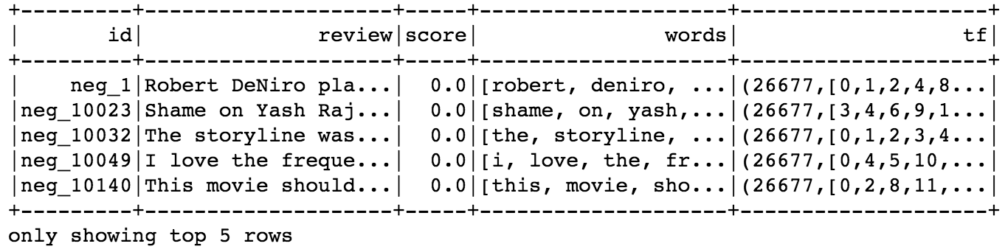
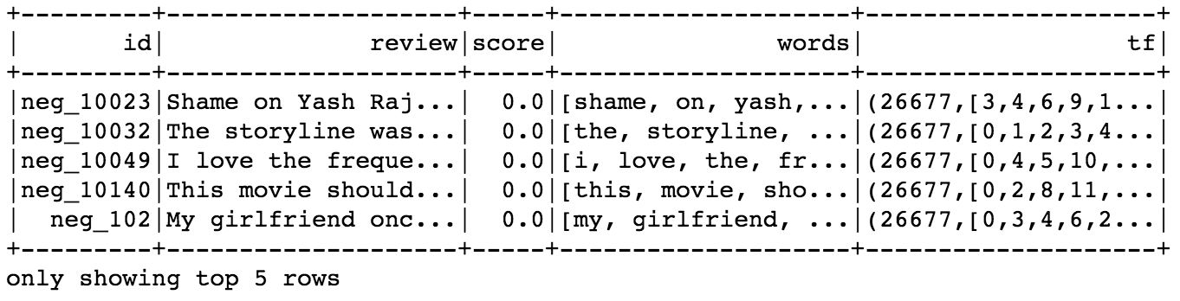
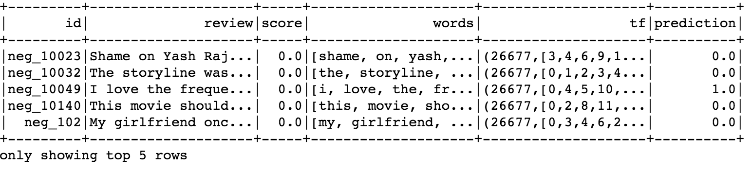
Spark ML: Algorithms
Some Estimators are algorithms that work on DataFrames
In this context, an algorithm is a machine learning model
For example, LogisticRegression
Training data
tf (X)
LogisticRegression
(estimator)
LogisticRegression
(transformer)
score (y)
Testing data
tf (X)
LogisticRegression
(transformer)
prediction

Slide 74
Spark ML: Algorithms
Algorithms can be part of Pipelines
Pipelines can be combined with other Pipelines
Pipeline (estimator)
Pipeline (transformer)
LogisticRegression
(estimator)
Tokenizer
CounterVectorizer

Slide 75
Evaluators
An evaluator allows us to see how a given model performs according to specified criteria
An evaluator is used to select the best model from a group of models.
An evaluator compares model predictions to truth data and calculates a score indicating how well the model performed.

Slide 76
Summary (1 of 2)
Apache Spark is a fast, in-memory computing system that runs on Hadoop.
An application in Spark has several main components, including a driver program, worker nodes, executors and tasks.
The SparkContext object is a key component of the driver program.
An RDD is a fault-tolerant collection of elements that can be operated on in parallel.
There are several ways to create an RDD in Spark: the parallelize function or a reference to a file in HDFS. textFile sequenceFile
There are two types of operations that can be done on RDDs: transformations and actions.

Slide 77
Summary (2 of 2)
MLlib is a Spark implementation of some common machine learning algorithms and utilities.
MLlib contains algorithms for classification, regression, clustering and recommendation.
Transformers convert raw data in some way
Estimators need to learn something from the data in order to transform the data
Pipelines are a collection of transformers and estimators

